Slide 1
Mohammed Hasan Goni
Data Scientist

Slide 2
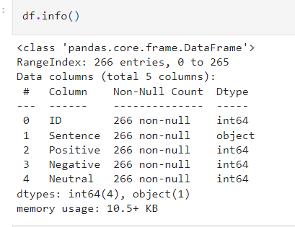
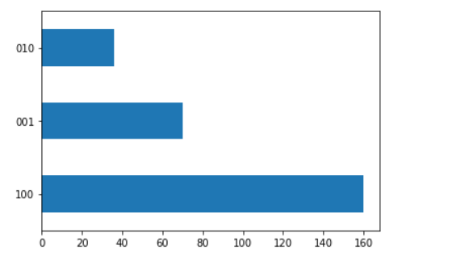
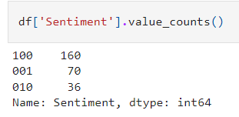
Feeling about the data

Slide 3
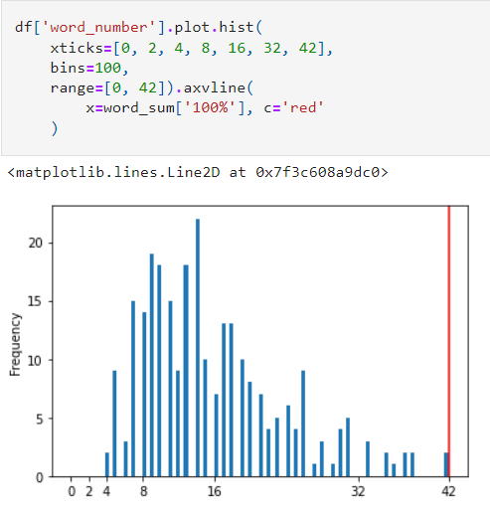
Distribution of words after preprocessing
- small letter conversion
- stop words removal
- Stemming
- Lemmetization

Slide 4
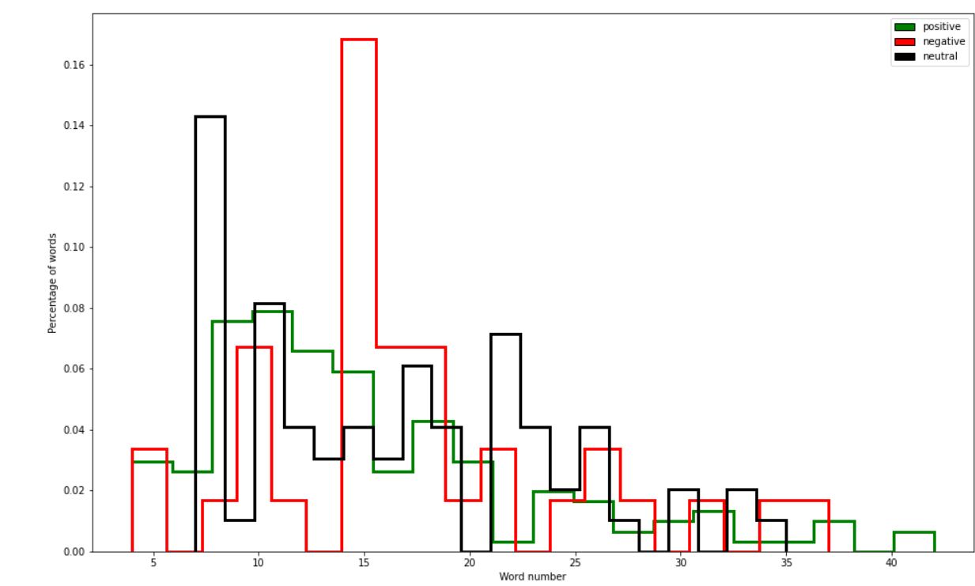
Distribution of words after preprocessing based on different classes

Slide 5
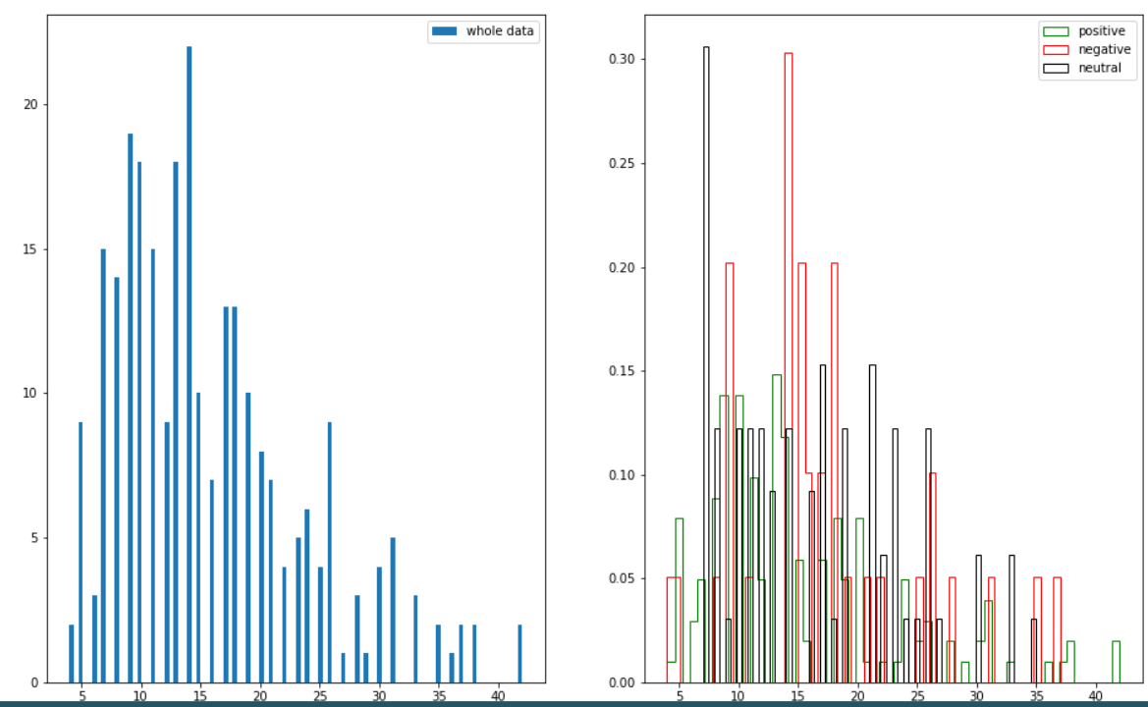
Distribution of words after preprocessing based on different classes

Slide 6
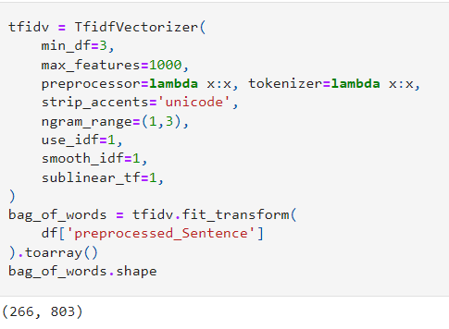
Converting words to Vector (or Embedding)

Slide 7
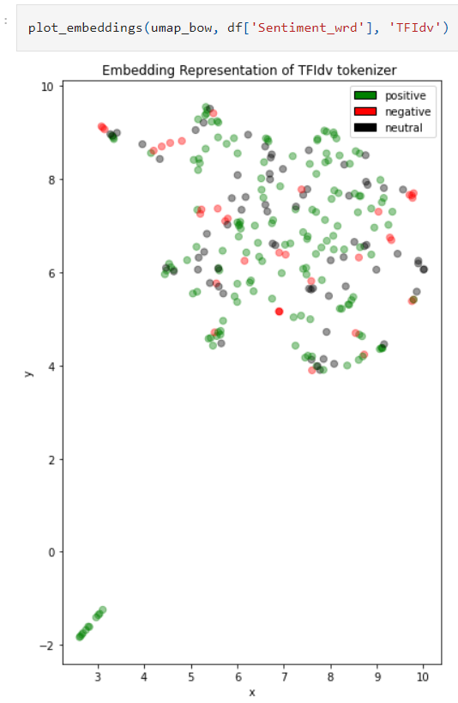
Visualization based on UMAP(TFIdv)

Slide 8
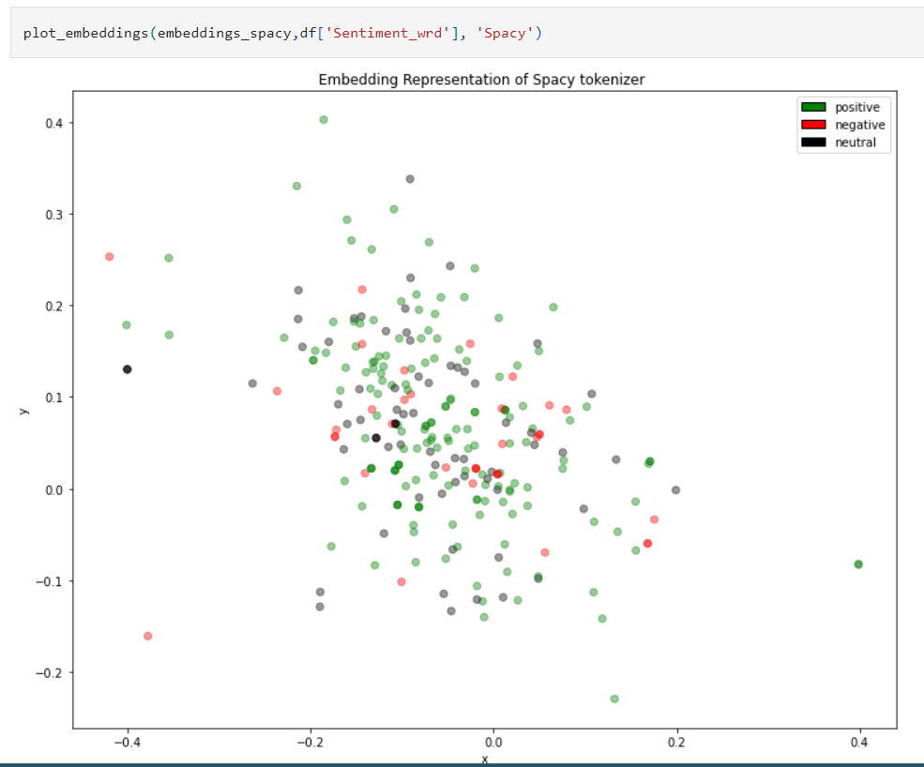
Visualization
based on UMAP(Spacy)

Slide 9
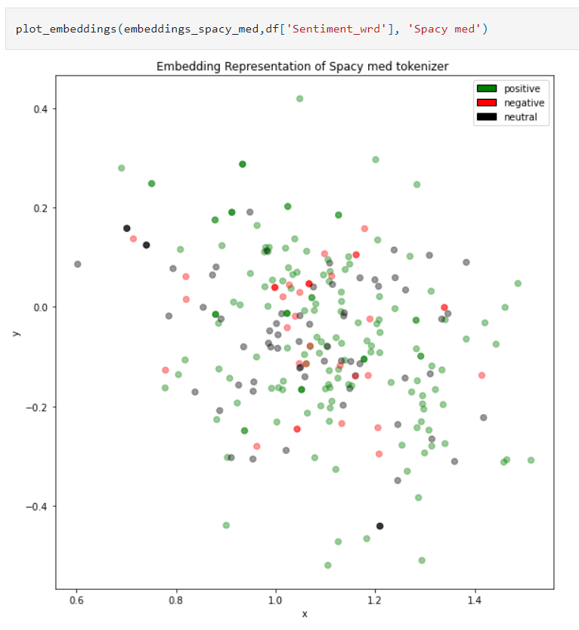
Visualization
based on UMAP(Scispacy)

Slide 10
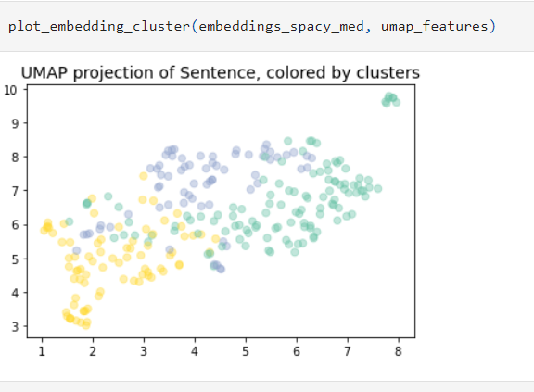
Clustering visualization
based on UMAP(k-means)

Slide 11

Balanced ?
under sampling
over sampling
SMOTE

Slide 12
Is data sufficient for hold out ?
K-Fold( k=5 ) is used

Slide 13

Enough data for deep learning ?
- Deep learning model can create overfitting
- Use relative simple model (linear model)
- Add regularization

Slide 14
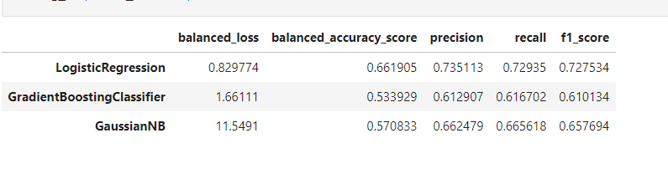
Different models performence

Slide 15
Different models performence

Slide 16
Logistic Regression will be used as a winner

Slide 17

Approaches to add uncertainity
- One solution would be before labelling the data the labeller should have a meeting and create some rules in case of such confusing cases
- In our case we can see the probability of three labels, if the difference will not huge, then there should be some trigger to inform the user about it. e.g. [0.33 0.34 0.33]. The label will be index no 1, however the difference is very small between such labels, means our model is not very confident aboout the prediction

Slide 18


Interpretability
- based on game theory (SHAP values)

Slide 19
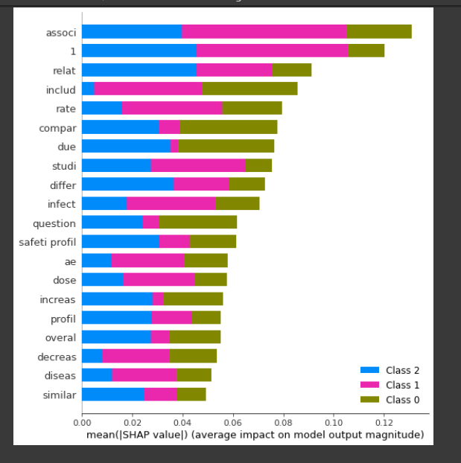
Interpretability

Slide 20
Interpretability
- based on game theory (SHAP values)

Slide 21
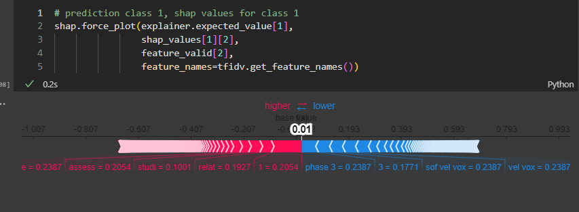
Interpretability

Slide 22
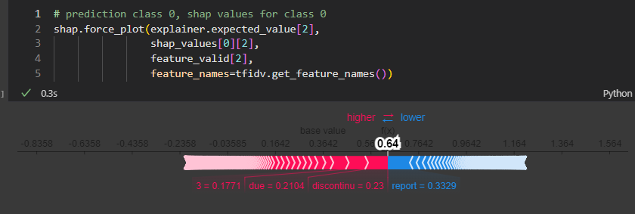
Interpretability

Slide 23
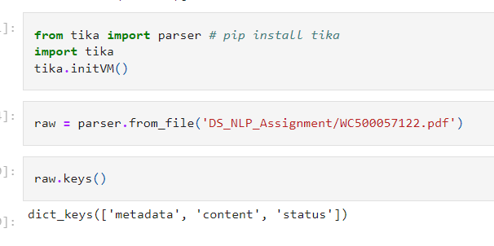
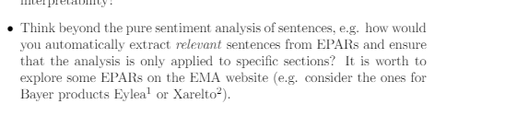
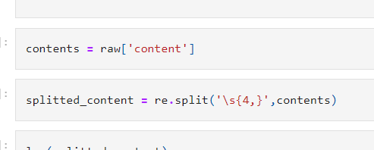
Similarity in a document and then sentiment analysis

Slide 24
further work
-gensim (doc2vec) similarity(e.g. cosine similarity)

Slide 25
Thanks
questions ?

